Slide 1
CAP Theorem
System Design(SD)(22CS024)
Bachelor of Engineering- Computer Science & Engineering
Department of Computer Science & Engineering
Chitkara University Institute of Engineering and Technology, Chitkara University, Punjab, India

Slide 2
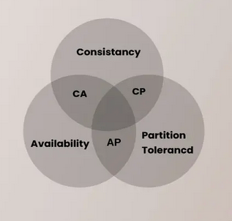
CAP Theorem
The CAP Theorem explains the trade-offs in distributed systems. It states that a system can only guarantee two of three properties: Consistency, Availability, and Partition Tolerance. This means no system can do it all, so designers must make smart choices based on their needs.
According to the CAP theorem, only two of the three desirable database characteristics—consistency, availability, and partition tolerance—can be shared or present in a networked shared-data system or distributed system.
Consistency (C)− Every read receives the most recent write or an error.
Availability (A)− Every request receives a response, even if it is not the most recent data.
Partition Tolerance (P)− The system continues to function despite network partitions.

Slide 3
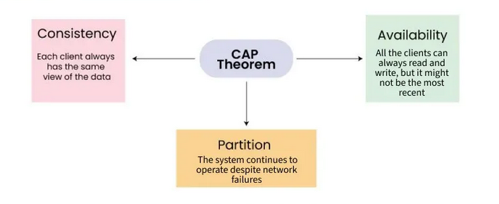
The computer scientist Eric Brewer presented the CAP Theorem, also called Brewer's theorem, at the Symposium on Principles of Distributed Computing in 2000.
The theorem provides a way of thinking about the trade-offs involved in designing and building distributed systems.
It helps to explain why certain types of systems may be more appropriate for certain use cases.
According to Brewer, the theorem states that a distributed system can have at most two of these guarantees.
Properties of CAP theorem

Slide 4
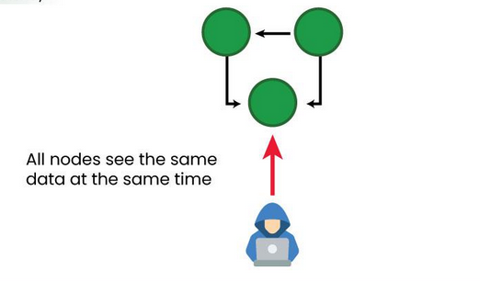
1. Consistency: Consistency defines that all clients see the same data simultaneously, no matter which node they connect to in a distributed system. For eventual consistency, the guarantees are a bit loose. Eventual consistency gurantee means client will eventually see the same data on all the nodes at some point of time in the future.
Example: If one node updates a value, other nodes in the system should reflect that updated value immediately.
Example− Traditional relational databases like MySQL prioritize consistency.
Explanation of the above Diagram:
All nodes in the system see the same data at the same time. This is because the nodes are constantly communicating with each other and sharing updates.
Any changes made to the data on one node are immediately propagated to all other nodes, ensuring that everyone has the same up-to-date information.

Slide 5
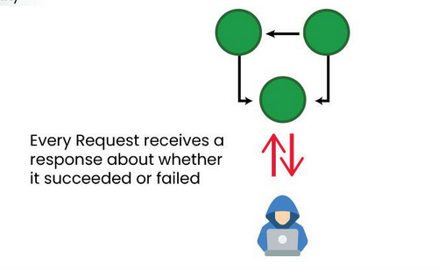
2. Availability: Availability defines that all non-failing nodes in a distributed system return a response for all read and write requests in a bounded amount of time, even if one or more other nodes are down.
Example− Systems like DNS ensure high availability even at the expense of providing slightly outdated data.
Explanation of the above Diagram:
User send requests, even though we don't see specific network components. This implies that the system is available and functioning.
Every request receives a response, whether successful or not. This is a crucial aspect of availability, as it guarantees that users always get feedback.

Slide 6
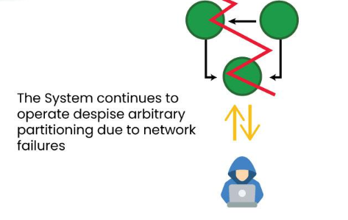
3. Partition Tolerance: Partition Tolerance defines that the system continues to operate despite arbitrary message loss or failure in parts of the system. Distributed systems guranteeing partition tolerance can gracefuly recover from partitions once the partition heals.
Example− Modern distributed databases like Cassandra and MongoDB prioritize partition tolerance.
Explanation of the above Diagram:
Addresses network failures, a common cause of partitions. It suggests that the system is designed to function even when parts of the network become unreachable.
The system can adapt to arbitrary partitioning, meaning it can handle unpredictable network failures without complete failure.

Slide 7
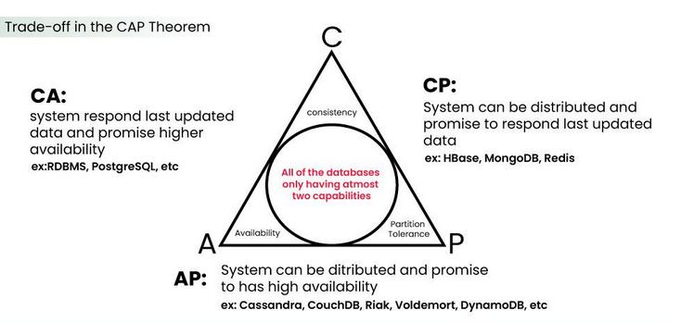

Slide 8
1. CA System
A CA System delivers consistency and availiability across all the nodes. It can't do this if there is a partition between any two nodes in the system and therefore does't support partition tolerance.
2. CP System
A CP System delivers consistency and partition tolerance at the expense of availability. When a partition occurs between two nodes, the systems shuts down the non-available node until the partition is resolved. Some of the examples of the databases are MongoDB, Redis, and HBase.
3. AP System
An AP System availability and partition tolerance at the expense of consistency. When a partition occurs, all nodes remains available, but those at the wrong end of a partition might return an older version of data than others. Example: CouchDB, Cassandra and Dyanmo DB, etc.
IMPLICATIONS::
CP (Consistency, Partition tolerance) Systems− Focus on consistency and partition tolerance but sacrifice availability.
AP (Availability, Partition tolerance) Systems− Focus on availability and partition tolerance but sacrifice consistency.
CA (Consistency, Availability) Systems− Focus on consistency and availability but cannot handle network partitions.

Slide 9
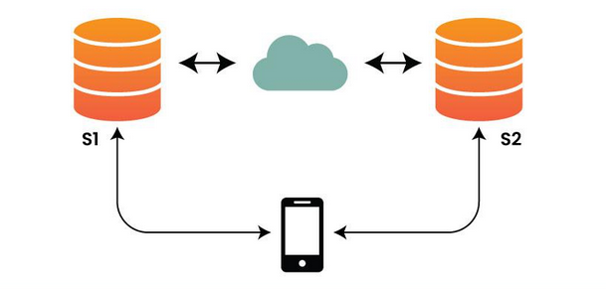
EXAMPLE
We have a simple distributed system where S1 and S2 are two server. The two server can talk to each other. Here, System is partition tolerant. Here We will prove that system can be either consistent or available.
Suppose there is a network failure and S1 and S2 cannot talk to each other. Now assume that the client makes a write to S1. The client then send a read to S2.
Given S1 and S2 cannot talk, they have different view of the data. If the system has to remain consistent, it must deny the request and thus give up on availability.
If the system is available, then the system has to give up on consistency. This proves the CAP Theorem.

Slide 10
1. Banking Transactions (CP System)
Problem Statement:
Imagine a bank teller updating your account balance on a secure computer system. This system prioritizes consistency (C) and partition tolerance (P).
2. Social Media Newsfeed (AP System)
Problem Statement:
Think of your newsfeed on a social media platform constantly updating with new posts and stories. This system prioritizes availability (A) and partition tolerance (P).

Slide 11
Advantages of CAP Theorem in System Design
Provides a Framework for Decision-Making
Promotes Understanding of Trade-offs
Guides System Architecture and Technology Selection
Enhances System Resilience and Performance
Disadvantages of CAP Theorem in System Design
Oversimplification
Abstract Trade-offs
Lack of Guidance for Hybrid Systems
Potential Misinterpretation

Slide 12
CONSISTENCY PATTERN
Consistency in system design refers to the property of ensuring that all nodes in a distributed system have the same view of the data at any given point in time, despite possible concurrent operations and network delays. In simpler terms, it means that when multiple clients access or modify the same data concurrently, they all see a consistent state of that data.
Importance of Consistency in System Design
Correctness
Trust and Reliability
Data Integrity
Concurrency Control
User Experience
Predictability
For example, if a bank account has a balance of $500, two users accessing the account from different locations should see the same balance.

Slide 13
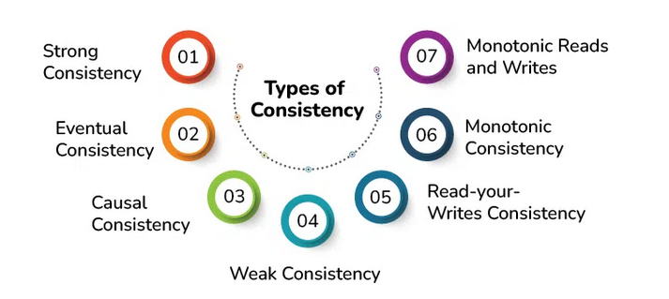
Consistency in CAP
In systems prioritizing consistency (C), every read operation reflects the most recent write. However, this may come at the cost of availability during network partitions.
Types of Consistency Models
Consistency models define how and when updates to a distributed system become visible to users. They include−
Strong Consistency
Ensures that all clients see the most recent data after a write operation.
Example− Traditional relational databases like MySQL.

Slide 14
Eventual Consistency
Guarantees that all nodes will converge to the same state eventually, though not immediately.
Example− DNS systems or NoSQL databases like Cassandra.
Causal Consistency
Guarantees that causally related operations are seen by all nodes in the same order.
Example− Collaborative editing tools.
Read-Your-Writes Consistency
Ensures that after a user writes data, they will see their own updates in subsequent reads.
Example− User profile updates on social media.
Monotonic Consistency
1. ensures that if a client observes a particular order of updates (reads or writes) to a data item, it will never observe a conflicting order of updates.
2. prevents the system from reverting to previous states or seeing inconsistent sequences of updates, which helps maintain data integrity and coherence.

Slide 15
Monotonic Reads and Writes
ensure that if a client performs a sequence of reads or writes, it will observe a monotonically increasing sequence of values or updates.
ensure that clients never see older values in subsequent reads, while monotonic writes guarantee that writes from a single client are applied in the same order on all replicas.
Challenges with maintaining Consistency
Network Latency− Delays in communication between nodes can lead to stale data.
Partitioning− Network partitions can disrupt data synchronization.
Concurrency− Concurrent updates from multiple clients can lead to conflicts.
Scalability− Ensuring consistency across a large number of nodes can reduce system performance.
Cost− Consistency mechanisms, such as consensus algorithms, can be resource-intensive.
Techniques for Ensuring Consistency
Two-Phase Commit (2PC)
A protocol for coordinating transactions across multiple nodes−
Prepare Phase− Nodes vote on whether to commit the transaction.
Commit Phase− If all nodes agree, the transaction is committed.
Drawback− 2PC can block nodes during failures, impacting availability.

Slide 16
Quorum-Based Replication
In this method−
A quorum is a majority of nodes required to acknowledge a write or read.
Example−
Write Quorum− Data is written to W nodes.
Read Quorum− Data is read from R nodes.
Ensures consistency if R+W > NR + W > N (total nodes).
Consensus Algorithms
These algorithms help nodes agree on a single source of truth.
Paxos− Guarantees consensus in the presence of node failures.
Raft− Simpler and easier-to-understand alternative to Paxos.
Conflict Resolution Strategies
When concurrent updates conflict, strategies include−
Last Write Wins (LWW)− The most recent update overwrites older ones.
Custom Application Logic− Application-specific rules for resolving conflicts.
Vector Clocks− Track causality to identify conflicts.

Slide 17
Trade-offs in Consistency
Designing for consistency often involves trade-offs with other system properties−
Consistency vs. Availability
Systems prioritizing availability may sacrifice consistency during failures (e.g., eventual consistency).
Consistency vs. Performance
Strong consistency requires synchronization across nodes, increasing latency.
Consistency vs. Scalability
Maintaining consistency in highly scalable systems can lead to bottlenecks.

Slide 18
Real-World Examples
Example 1: Banking Systems
Strong consistency ensures that a user's bank balance is always accurate, even with concurrent transactions.
Techniques− Distributed transactions, 2PC.
Example 2: Social Media Platforms
Eventual consistency is often sufficient for non-critical operations like post visibility.
Techniques− Replication with conflict resolution.
Example 3: E-Commerce Websites
Product inventory must maintain strong consistency to prevent overselling.
Techniques− Consensus algorithms or locking mechanisms.

Slide 19
Differences
Aspect | Weak Consistency | Eventual Consistency
Synchronization | Lack of strict synchronization between replicas | Asynchronous replication of updates
Convergence Guarantee | No guarantee of convergence or synchronization | Guarantees eventual convergence of replicas
Divergence Tolerance | Allows significant divergence between replicas | Tolerates temporary divergence between replicas
Timing of Convergence | No specification on timing of convergence | Ensures eventual convergence but does not specify time
Ordering of Updates | No strict requirements on ordering of updates | Allows loose ordering of updates
Use Cases | Frequently used in caching systems and certain non-critical data scenarios | Commonly employed in distributed databases, cloud storage, and CDN
Impact on Performance | Offers potential performance benefits due to reduced synchronization overhead | May introduce temporary inconsistencies but provides eventual consistency and scalability benefits
Aspect | Weak Consistency | Eventual Consistency

Slide 20
Differences
Parameters | Strong Consistency | Eventual Consistency
Definition | Guarantees that all reads reflect the most recent write | Ensures that all replicas converge to the same value eventually
Data Freshness | Immediate consistency after a write | Temporary inconsistencies allowed, and eventual consistency
Latency | Higher latency due to synchronization | Lower latency due to asynchronous updates
Availability | Lower availability during network partitions (CAP theorem) | Higher availability even during network partitions (CAP theorem)
Partition Tolerance | Can be compromised for consistency | Prioritized alongside availability
Complexity | More complex to implement due to synchronization | Simpler implementation, fewer synchronization requirements
Use Cases | Financial transactions, inventory management, session management | Social media feeds, DNS, caching systems
Performance | Potentially slower due to synchronization overhead | Generally faster due to relaxed consistency
Scalability | More challenging to scale due to synchronization needs | Easier to scale across multiple nodes
Read/Write Operations | Synchronous, ensuring the latest data is read | Asynchronous, allowing for faster operations but with potential delays in consistency

Slide 21
Functional and Non Functional Requirements
Requirements analysis is an essential process that enables the success of a system or software project to be assessed. Requirements are generally split into two types: Functional and Non-functional requirements. functional requirements define the specific behavior or functions of a system. In contrast, non-functional requirements specify how the system performs its tasks, focusing on attributes like performance, security, scalability, and usability.
What are Functional Requirements?
These are the requirements that the end user specifically demands as basic facilities that the system should offer. All these functionalities need to be necessarily incorporated into the system as a part of the contract.
These are represented or stated in the form of input to be given to the system, the operation performed and the output expected.
They are the requirements stated by the user which one can see directly in the final product, unlike the non-functional requirements.
Examples:
What are the features that we need to design for this system?
What are the edge cases we need to consider, if any, in our design?

Slide 22
What are Non-Functional Requirements?
These are the quality constraints that the system must satisfy according to the project contract. The priority or extent to which these factors are implemented varies from one project to another. They are also called non-behavioral requirements. They deal with issues like:
Portability
Security
Maintainability
Reliability
Scalability
Performance
Reusability
Flexibility
Examples:
Each request should be processed with the minimum latency
System should be highly available.

Slide 23
Example:
Response Time− The page should load in under 2 seconds for 93% of users.
Scalability Requirements: The systems ability to handle growth in data volume, users, or transactions.
Example− The system should support up to 10,000 concurrent users.
Security Requirements: Requirements for data protection, encryption, and access control.
Example− Passwords must be hashed and salted before storage.
Usability Requirements: Requirements related to the ease of use and learnability of the system.
Example− All core functions should be accessible with no more than three clicks.
Reliability and Availability Requirements: Defines the systems expected uptime and error tolerance.
Example− The system should have 99.9% uptime.
Maintainability and Portability: Requirements for the ease of maintenance, debugging, and migration.
Example− Code should follow documented standards to ensure maintainability.

Slide 24
Examples
1. Online Banking System
1. Functional Requirements:
Users should be able to log in with their username and password.
Users should be able to check their account balance.
Users should receive notifications after making a transaction.
2. Non-functional Requirements:
The system should respond to user actions in less than 2 seconds.
All transactions must be encrypted and comply with industry security standards.
The system should be able to handle 100 million users with minimal downtime.
2. Food Delivery App
1. Functional Requirements
Users can browse the menu and place an order.
Users can make payments and track their orders in real time.
2. Non-functional Requirements:
The app should load the restaurant menu in under 1 second.
The system should support up to 50,000 concurrent orders during peak hours.
The app should be easy to use for first-time users, with an intuitive interface.

Slide 25
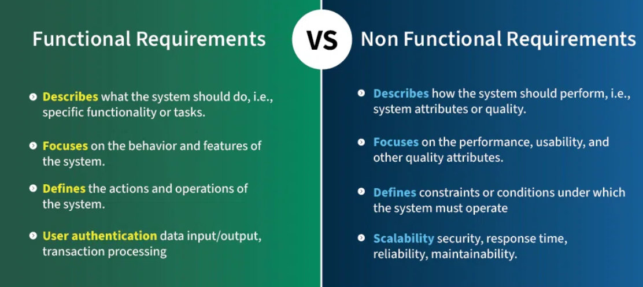

Slide 26
Challenges in Managing Functional and Non-Functional Requirements
Ambiguity and Misinterpretation− Vague requirements lead to misunderstandings. Use clear, specific language.
Changing Requirements: Requirements may change frequently; use Agile methodologies for flexibility.
Conflict between Functional and Non-Functional Goals− Trade-offs may be required (e.g., security vs. usability).
Prioritization Issues− High-priority non-functional requirements (like security) may be overlooked.
Stakeholder Alignment− Ensuring all stakeholders agree on priorities and definitions.
Tests for Non-Functional Requirements
Load Testing for performance requirements.
Usability Testing for user experience.
Security Audits for security and compliance requirements.
Iterative Review and Refinement, Regularly revisit requirements for completeness and relevancy.
Use Automation, Track requirements in real-time, using tools like JIRA, Confluence, and Trello for traceability.

Slide 27
What are the techniques for Gathering Requirements?
Gathering requirements involves multiple approaches and collaboration between the development team, stakeholders, and end-users:
1. Functional Requirements:
Interviews: Talk to stakeholders or users to understand their needs.
Surveys: Distribute questionnaires to gather input from a larger audience.
Workshops: Host sessions to brainstorm features and gather feedback.
2. Non-functional Requirements:
Performance Benchmarks: Consult with IT teams to set expectations for performance and load.
Security Standards: Consult with security experts to define the best practices for data protection.
Usability Testing: Test the system to find areas where users might struggle and refine the interface.

Slide 28
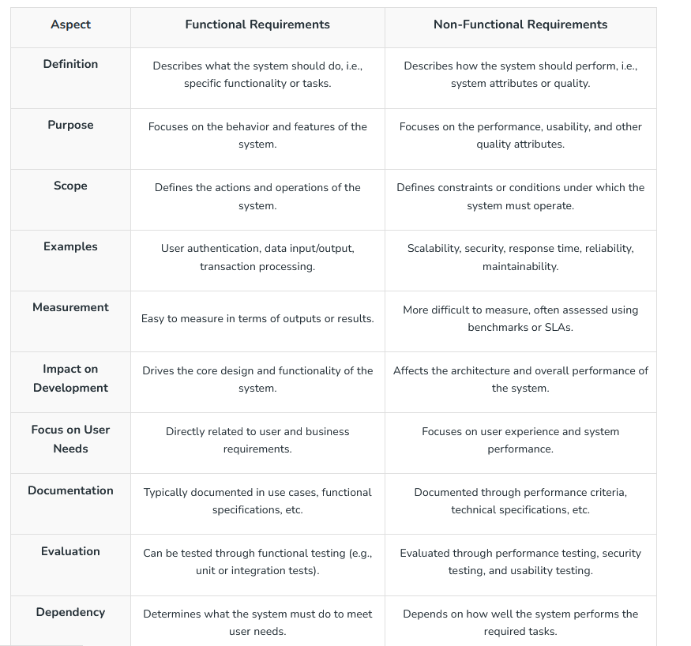

Slide 29
Importance of Balancing Both Functional and Non-Functional Requirements
As functional and non-functional requirements address distinct but equally significant components of the system, it is essential that they be balanced in system design. Here's why balancing them is essential:
Improves User Experience: A system that functions but is slow, unresponsive, or challenging to operate could be the consequence of concentrating only on the functional requirements. Usability, performance, and availability are examples of non-functional criteria that have a big influence on how users interact with the system and how satisfied they are.
Enhances System Performance: Scalability, dependability, and security are examples of non-functional features that guarantee the system operates effectively in real-world situations. Failure may ensue from a system that satisfies functional requirements but is unable to scale or manage a high user volume. By keeping these in balance, the system is guaranteed to function properly.
Prevents Bottlenecks and Failures: Systems that function well but lack security or dependability are more likely to experience malfunctions, breaches, or outages. The system is made more robust and less vulnerable to bottlenecks by taking non-functional criteria into account.
Reduces Long-Term Costs: Systems designed with only functional requirements in mind often encounter scalability and maintainability issues as they grow. Addressing non-functional requirements early on prevents costly changes, re-architecting, or performance enhancements later.
Supports System Evolution: Non-functional requirements such as maintainability and extensibility make future updates, feature additions, and system scaling easier and less disruptive. This balance ensures that the system can evolve and adapt over time without significant hurdles.

Slide 30
Common Challenges in Defining these Requirements
Defining both functional and non-functional requirements in system design can be challenging due to several factors. Here are some common challenges:
Ambiguity in Requirements: Requirements are often unclear, making it difficult to interpret what the system should do (functional) and how it should perform (non-functional).
Changing Requirements: As projects evolve, functional and non-functional requirements often change due to shifting business goals, market trends, or user needs.
Difficulty in Prioritization: Deciding which functional and non-functional requirements are most important is often difficult. Functional needs can overshadow non-functional ones, such as security or scalability.
Measuring Non-Functional Requirements: Functional requirements are often straightforward to test, but non-functional requirements like usability, scalability, and reliability are harder to measure and validate.
Overlapping or Conflicting Requirements: Sometimes, functional and non-functional requirements can overlap or conflict. For example, adding complex security features (non-functional) might slow down the performance (another non-functional requirement).

